Slide 1
Character Design Presentation

Slide 2
My Aim
Make two near game ready characters.
Possibly rig one if I have time, test in unreal engine.
Improve on any previous mistakes.
Create a good enough portfolio piece to show future employers.

Slide 3
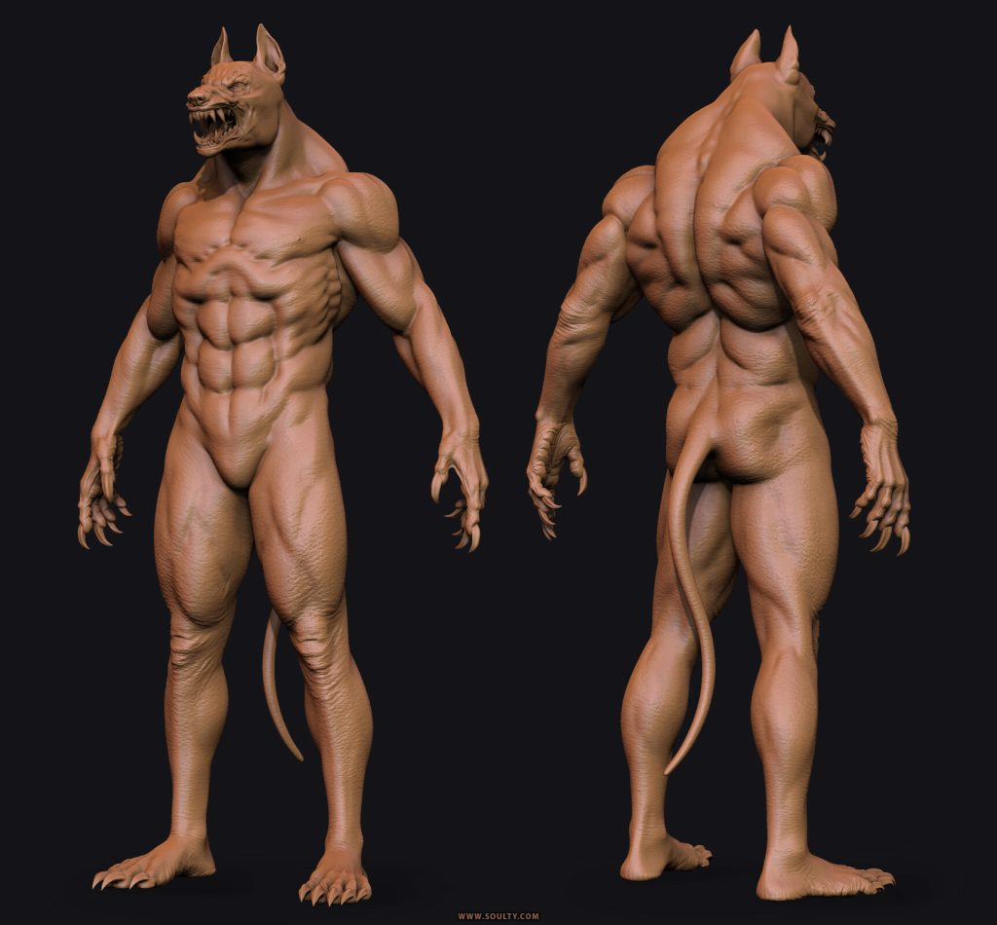
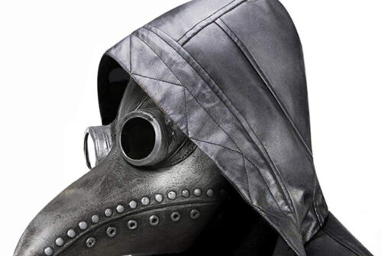
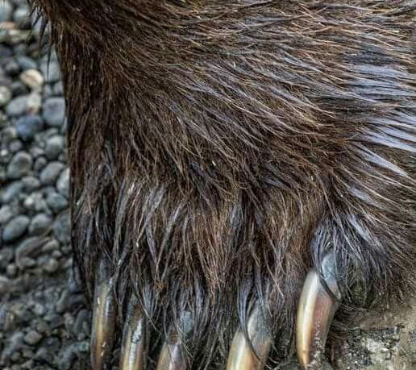
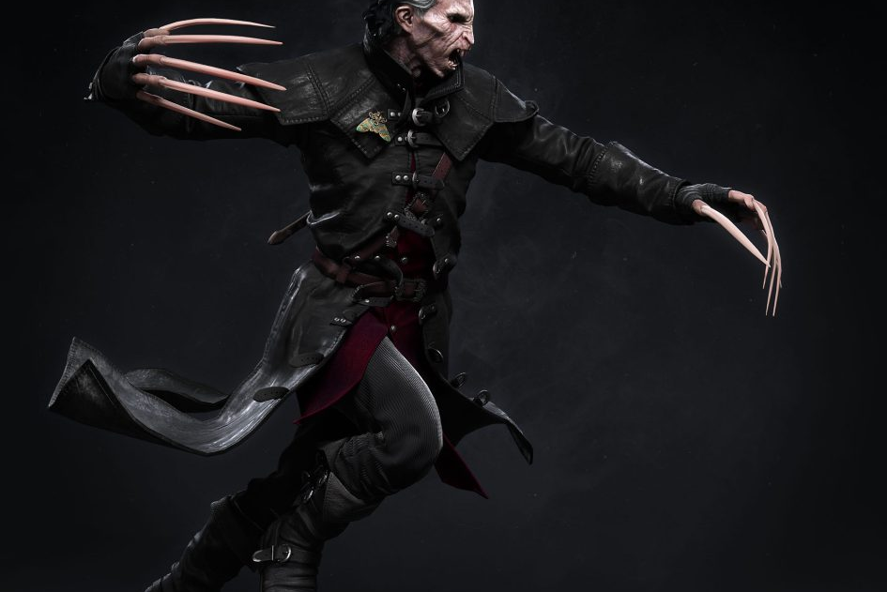
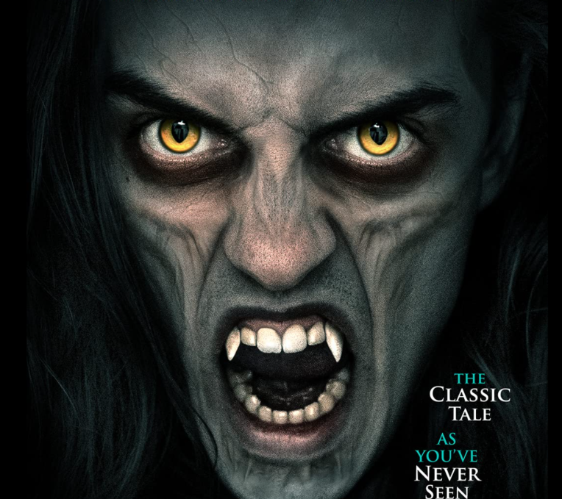
1st Character Idea
Medieval Doctor, medical experiment gone wrong
Looked into different characters from games, historical events, and other bits of media.
Looked into animals and their different features.

Slide 4
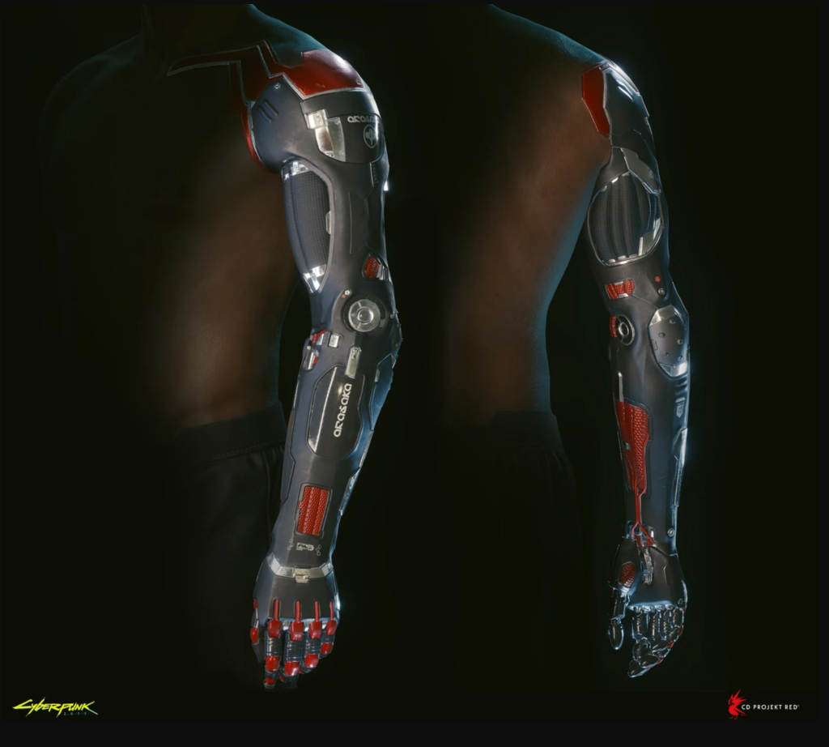
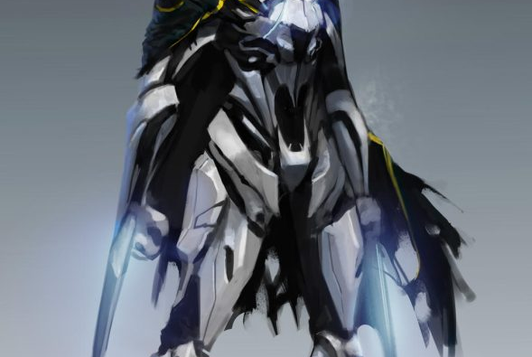
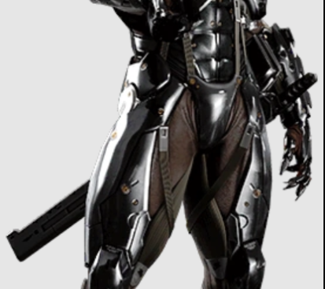
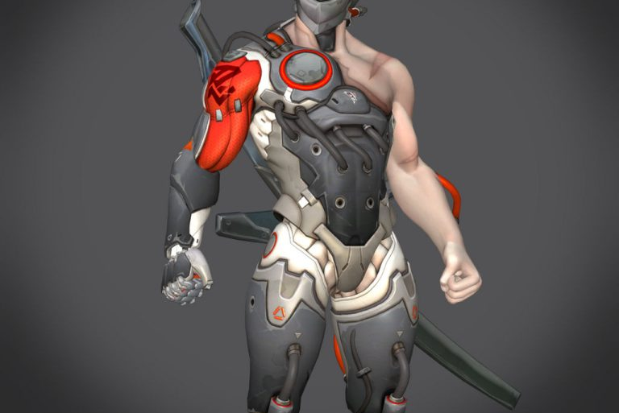
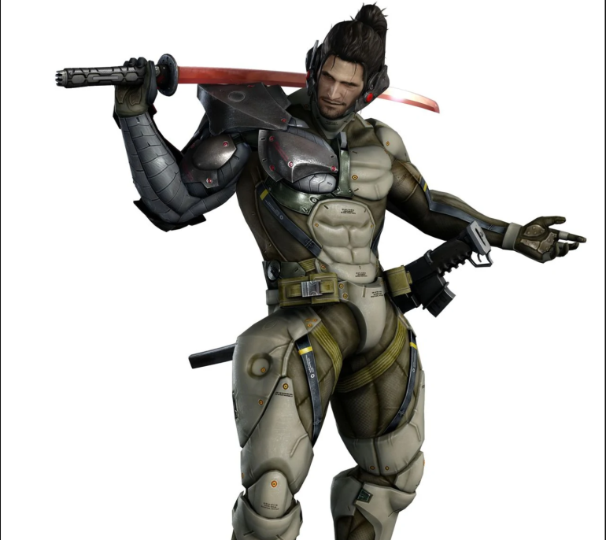
2nd Character Idea
Soldier saved with worlds first robotic parts treatment.
Game Characters, Metal Gear, Overwatch, Other media.
Potential features, robotic arms, hidden weapons AC.

Slide 5
The Process
Zbrush
Maya (if & when needed)
Substance Painter

Slide 6
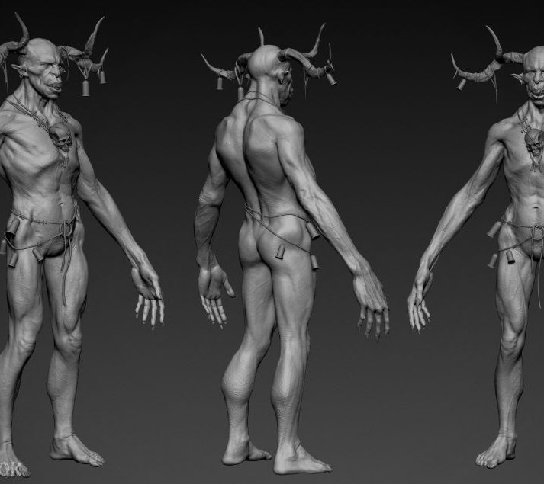
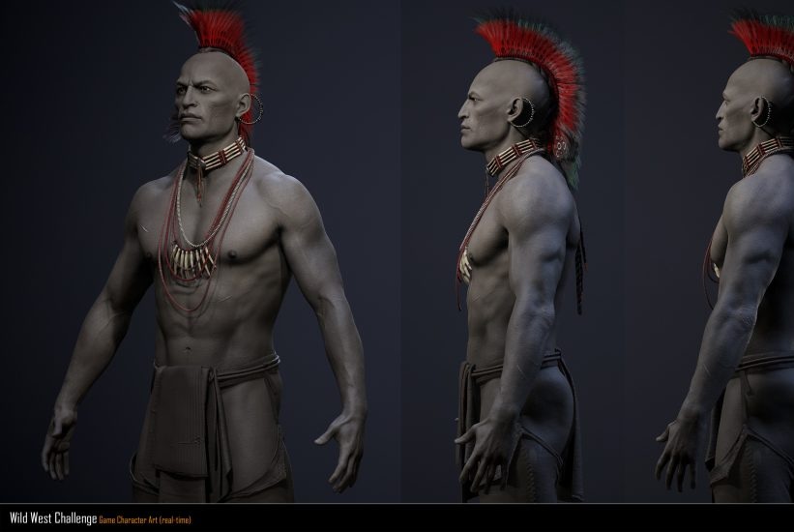
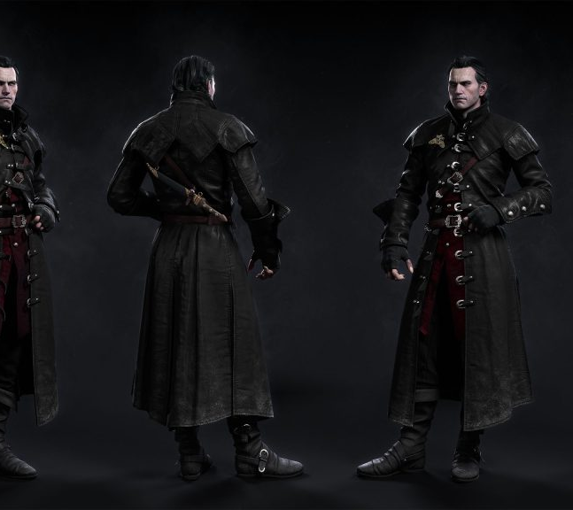
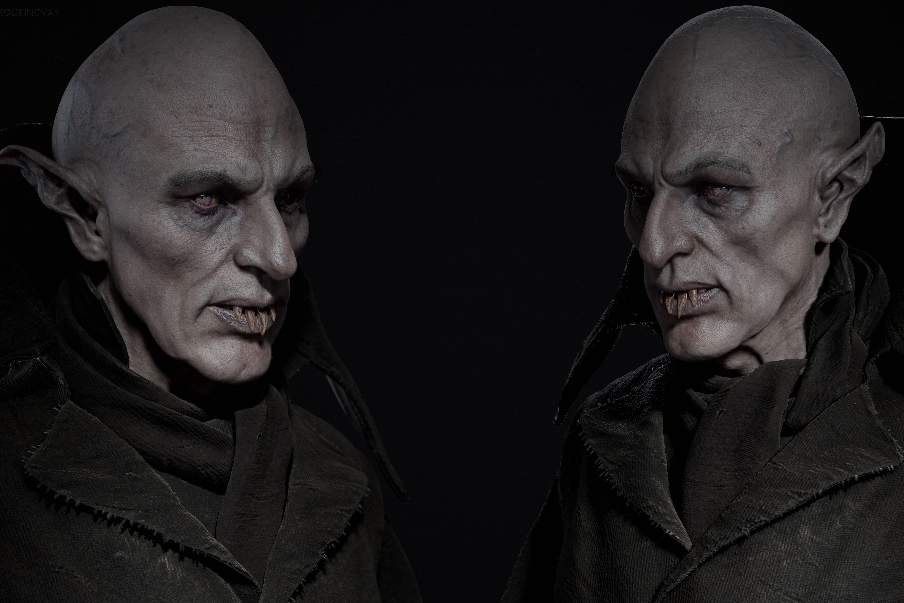
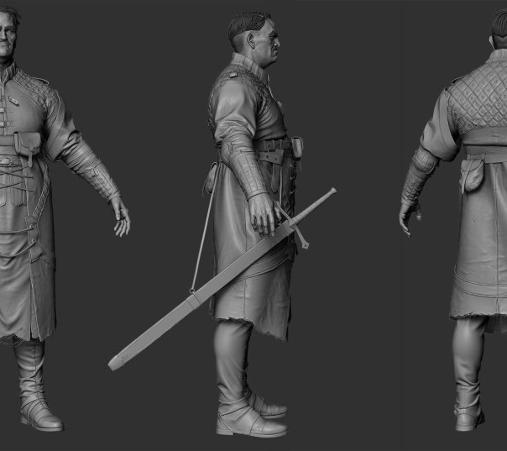
Art Style
Aiming for realism
Fits both of my ideas better

Slide 7
Why have I chosen these?
My own interests in medieval & Futuristic media.
Cyberpunk series, Dark souls, The Witcher.
Some uniqueness with the first character.
Second character is just something ive always wanted to do.

